Slide 1
Advancing Racial Equity and Inclusion through Program Design
NCDA – Summer Conference
June 17, 2021
Notes:
Acknowledge that I am only representing the work of many others in the City whose experience as people of color provides the authentic wisdom of the activities talked about in this presentation.
Acknowledge that this work is being done on the ancestral lands of the Duwamish tribe and other native clans.
Acknowledge that Equity and Inclusion also spans, race, ethnicity, country of heritage, age and experience, regionality, preferred language, being a person with a disability, religious or value based practice, gender identity and/or expression, and family of origin or choice. Forgive what I missed; but it is about who we are by our choice.

Slide 2
Opportunities for Equity
Examples here are grounded in:
Allocation and Program Design
Policy and Legislation benefitting LMI HH
Data informing Actions

Slide 3
Allocation and Program Design
Equitable Development Initiative: (EDI) fund RFP funds CBOs working in Seattle on anti-displacement strategies:
2021 Request for Proposals (RFP) Equitable Development - $6.8M (includes CDBG)
Contact michael.blumson@seattle.gov.
Equitable Development Initiative Fund Guidelines
RFP Application
Example Templates for Development Budget and Project Schedule Source (excel file)
Information for EDI RFP applicants - What is the Equitable Zoning Pilot?
Frequently Asked Questions
Notes:
EDI fund funds:
new economic opportunities
improving educational outcomes,
responding to the economic impacts of COVID-19
For the 2021 EDI funding round, approximately $6.8 million (including CDBG) is available to organizations working on anti-displacement efforts in high displacement risk neighborhoods, with a continued emphasis on serving BIPOC communities that have been targeted by systemic and institutional racism. The funds will be used for organizational capacity building, property acquisition, and capital expenses. See website for the following details:

Slide 4
Allocation and Program Design
2017 Assessment of Fair Housing (AFH):
All Home: Seattle/King County’s Continuum of Care
31 AFH recommendations integrated into the current 2018-2022 Consolidated plan. The City’s geographic area priorities are linked to the R/ECAPs identified in the AFH. Proposals may be given consideration for benefitting a R/ECAP community.
CoC has provided training on race and homelessness and reviews allocation processes with a social justice and racial equity lens.
Notes:
EDI fund funds:
new economic opportunities
improving educational outcomes,
responding to the economic impacts of COVID-19
For the 2021 EDI funding round, approximately $6.8 million (including CDBG) is available to organizations working on anti-displacement efforts in high displacement risk neighborhoods, with a continued emphasis on serving BIPOC communities that have been targeted by systemic and institutional racism. The funds will be used for organizational capacity building, property acquisition, and capital expenses. See website for the following details:

Slide 5
Allocation and Program Design
Office of Housing equity initiatives:
Racial Equity in Purchasing and Contracting
Community Preference program : Community preference allows housing developments to prioritize certain applicants when leasing or selling units in communities at high risk of displacement.
Community Preference Guidelines
Contact: Jessica Gomez
The City is committed to socially-responsible procurement and promoting social equity through our contracts. Ensure open and fair procurements, environmentally-sustainable solutions, best labor practices, access to equal benefits and utilization of women- and minority-owned businesses.
Notes:
For several years, community organizations requested that the City of Seattle Office of Housing (OH) and the Seattle Office for Civil Rights (SOCR) implement a community preference policy to help address displacement and advance racial equity. In February 2019, Mayor Durkan issued Executive Order 2019-02: Actions to Increase Affordability and Address Residential Displacement, which included a policy to allow community preference in high risk of displacement neighborhoods. The OH Administrative & Financial Plan further outlined the permissive community preference policy for City-funded rental and homeownership housing located in high risk of displacement areas that intends to affirmatively further fair housing, address displacement, and foster and sustain inclusive communities. Community preference allows housing developments to prioritize certain applicants when leasing or selling units in communities at high risk of displacement.

Slide 6
Policy and Legislation
Mayor’s Office (RSJI): The Seattle Race and Social Justice Initiative (RSJI) is a citywide effort to end institutionalized racism and race-based disparities in City government. RSJI builds on the work of the civil rights movement and the ongoing efforts of individuals and groups in Seattle to confront racism. The Initiative's long-term goal is to change the underlying system that creates race-based disparities in our community and to achieve racial equity.
Seattle Office of Civil Rights – Equity webpage: See Racial Equity Toolkit. SOCR sponsors multiple trainings, work with City Attorney’s Office on investigation and complaints and works to provide technical assistance to all departments on Race and Social Justice initiatives. An example of the Toolkit applied can be found at Department of Neighborhoods participatory budget process.
Seattle Human Resources, Workforce Equity: contact Felecia Caldwell. Workforce Equity is an extension of the City's Race and Social Justice Initiative - with a focus on the City's employees. Under Executive Order 2015-02, the Seattle Office for Civil Rights and Seattle Department of Human Resources partnered to create the first Workforce Equity Strategic Plan in July 2016. The Workforce Equity Division in SDHR oversees the Plan, its updates and the work described in Executive Order 2018-04: Anti-Harassment and Anti-Discrimination.

Slide 7
Policy and Legislation
Environmental Justice: In partnership with the community, Seattle developed the Equity & Environment Agenda--a strategy to address these disparities and ensure that all Seattle residents benefit from our progress. The Agenda, along with Seattle's Race and Social Justice Initiative, are helping us ensure that we prioritize equity and center race in our environmental solutions. Environmental Study on racial disparities for environmental hazards informed the AFH and the Consolidated Plan.
Municipal legislation establishing:
$15 Minimum Wage, Family Paid leave at the local level, followed by the State level and most recently proposed by Federal administration. Legislation like this particularly benefits LMI households who may otherwise have no employer sponsored benefits and tend to have overrepresentation of LMI BIPOC families and individuals
Renter Protection laws

Slide 8
Data that Informs Actions
OPCD Equitable Development Monitoring Program (EDMP): contact Diana Canzoneri. Ongoing source of data and analysis to inform City policies, programs, and investments-and to aid work community-based work. Launched in the fall of 2020 it includes:
Community Indicators selected based on concerns and priorities expressed by community members. Includes housing affordability, neighborhood livability, transportation, and education and economic opportunity.
Heightened Displacement Risk Indicators to increase our understanding of displacement and detect heightened displacement risks.
Information on Neighborhood Change including historical context and recent shifts in racial and ethnic demographics.

Slide 9
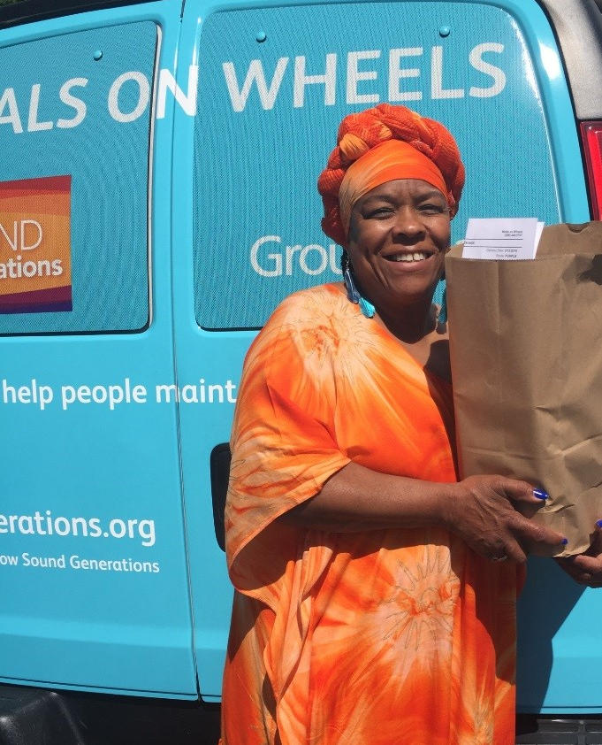
Debra Rhinehart Strategic Advisor, Human Services Department City of Seattle, 206-684-0574 Debra.Rhinehart@seattle.gov Dan Burton Federal Grants Manager, Human Services Department City of Seattle, 206-256-5415 Dan.Burton@seattle.gov

